Slide 1
Electronics Introduction
http://is.gd/elec_intro

Slide 2
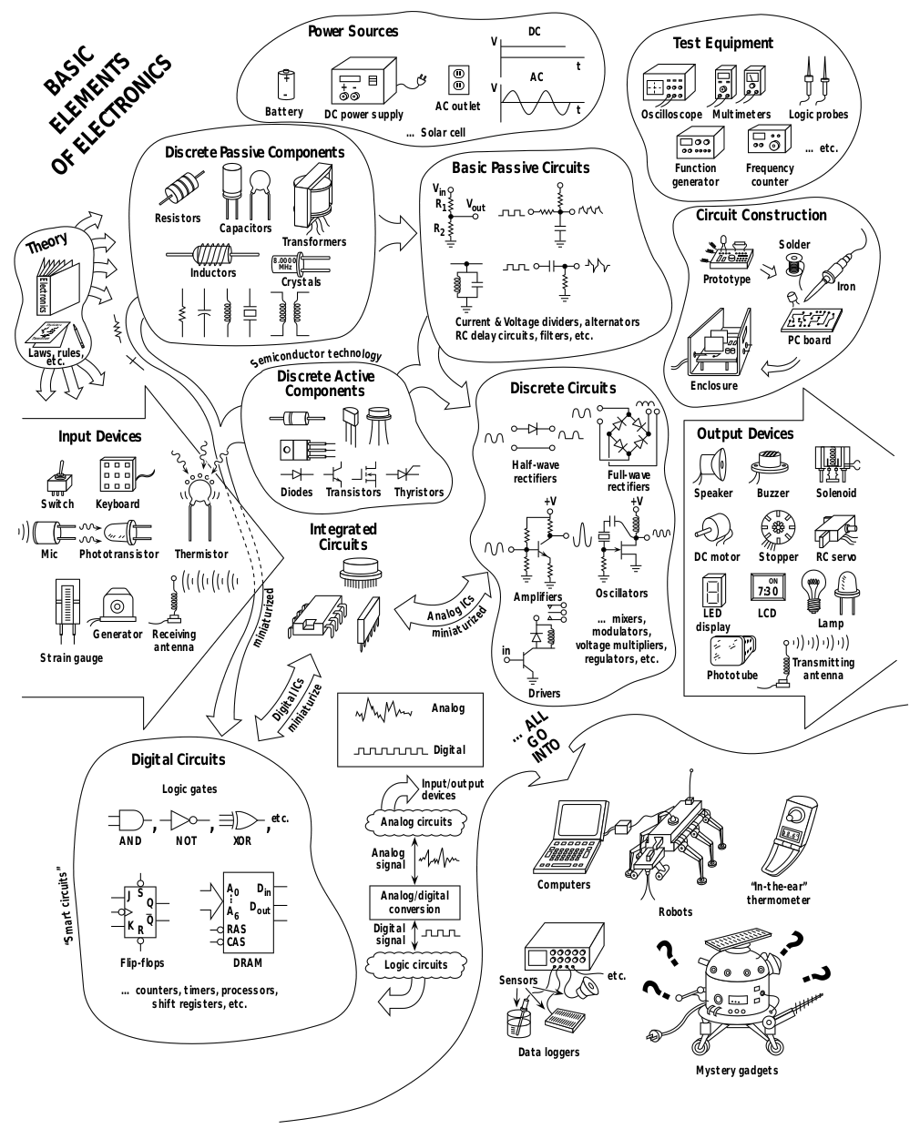
MENU
Components
Passive
Active
Logic
Applications
Fundamental Circuits
Sensors
Actuators
Processors
PRACTICAL ELECTRONICS FOR INVENTORS
Paul Scherz
(source)

Slide 3
1.a. Passive Components
Fundamentals
Resistors
Capacitors
Inductors
PRACTICAL ELECTRONICS FOR INVENTORS
Paul Scherz
(source)

Slide 4
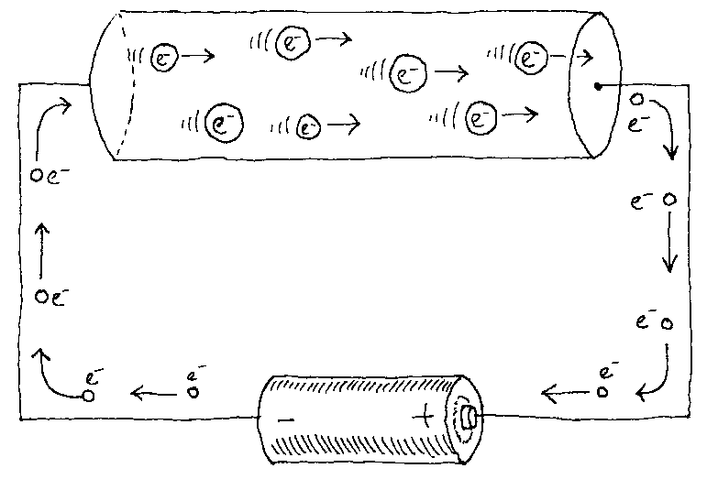
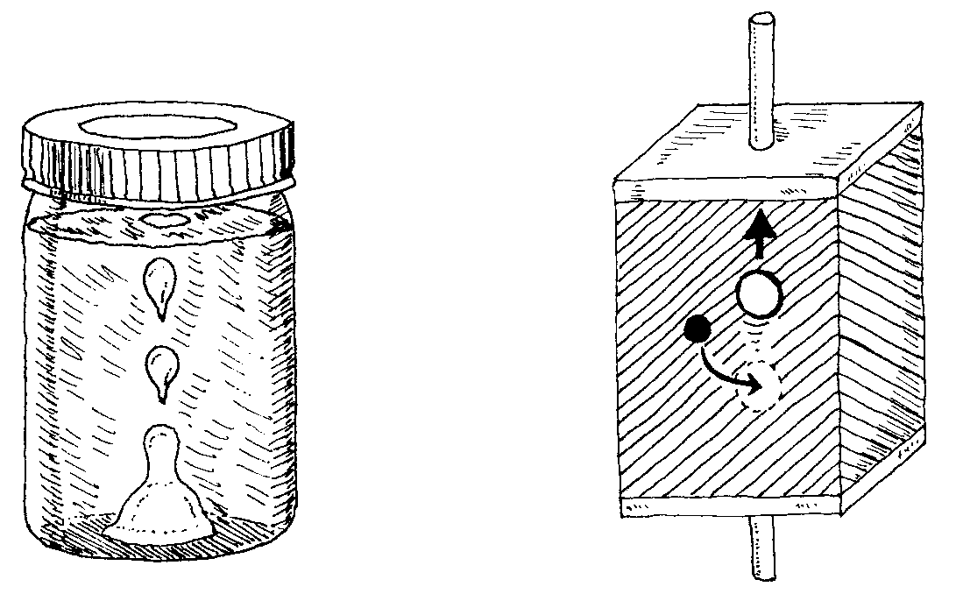
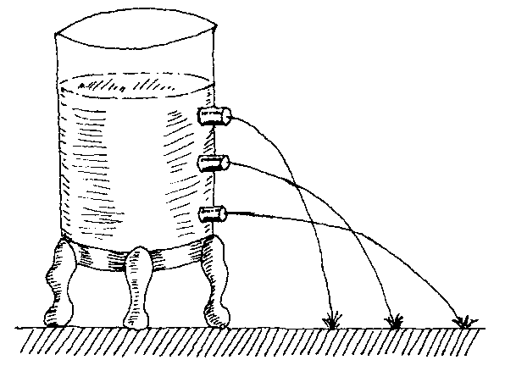
Fundamentals
Analogy water - electrons
Current (I): electrons (charged negatively), are attracted by the positive pin of the battery
Circulation: opposite of "electron holes" direction
Tension (U): More water => more pressure => more voltage
Electrons
circulation
(electrons)
source
Analogy:
"electron holes"
source
Analogy:
tension <=>pressure
source

Slide 5

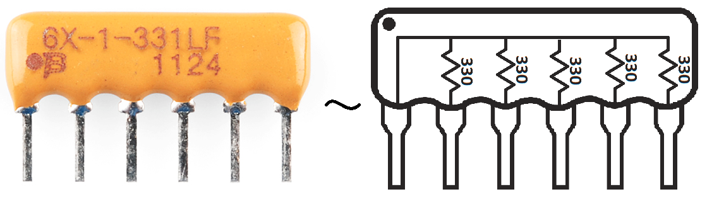
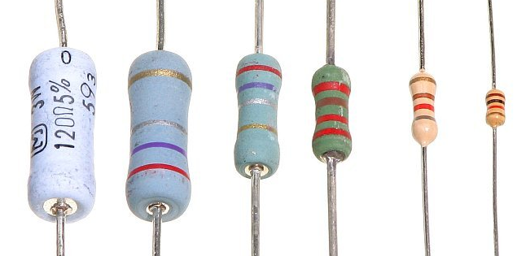
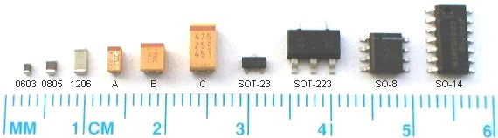
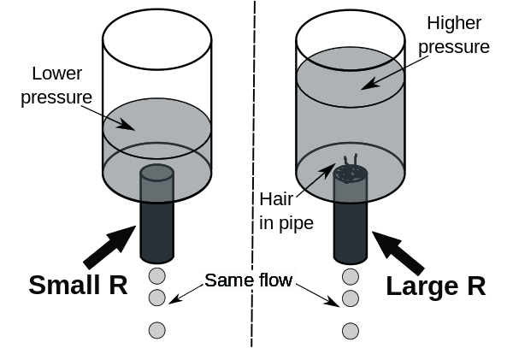
Resistors
Memo
Unit: Ω (ohm)
Symbol: R
U = R × I
P = U × I
Standard values: 0Ω .. 10MΩ
Usages
Decrease current
Voltage divider
Filters...
Resistor network
Tool: resistor color calculator

Slide 6
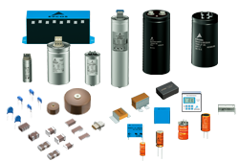
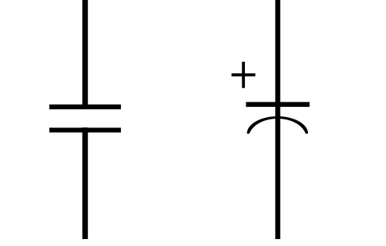
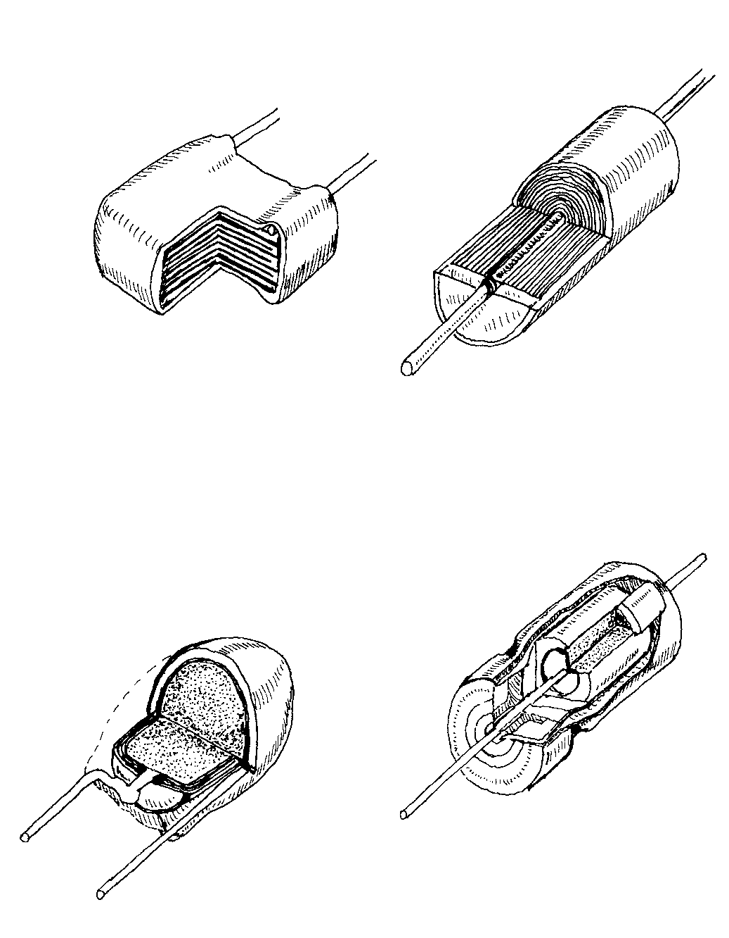
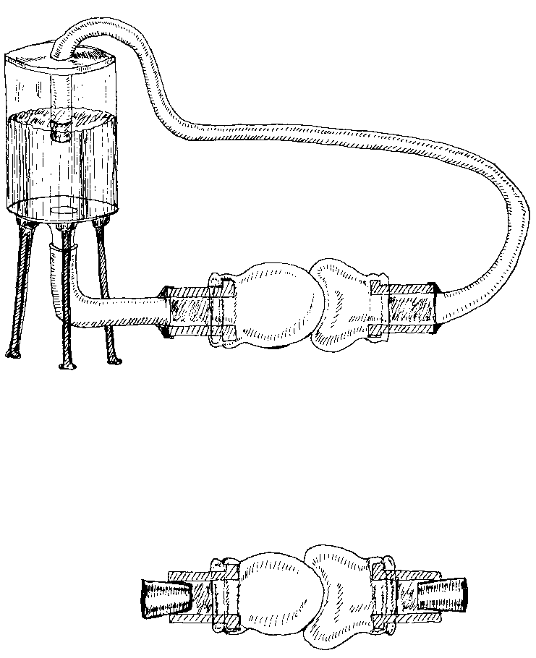
Capacitors
Memo
Unit: F (Farad)
Symbol: C (capacitance)
I = C dU/dt
Standard values: 0.1 pF - 1F
Usages
Local/temporary power storage (decoupling / bypass capacitor)
Filters…
Behavior (reactance)
High frequency ≈ wire
Low frequency ≈ disconnection
Xc = 1 / Cω (with ω = 2πf)
Battery charging capacitor
charged capacitor:

Slide 7
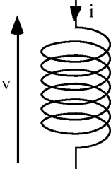
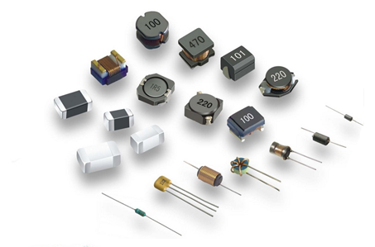
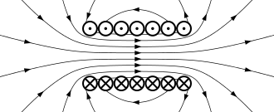
Inductors
Memo
Unit: H (Henry) - Inductance
Symbol: L
U = L dI/dt
Standard values: 1nH .. 1mH
Usages
Transformer (ex: 220V ⇔ 110V)
Electro-magnet (speakers...)
Filters…
Behavior (reactance)
Low frequency ≈ wire
High frequency ≈ disconnection
Xl = Lω (with ω = 2πf)

Slide 8
1.b. Active components
Diodes
Bipolar transistors
MOS transistors
PRACTICAL ELECTRONICS FOR INVENTORS
Paul Scherz
(source)

Slide 9
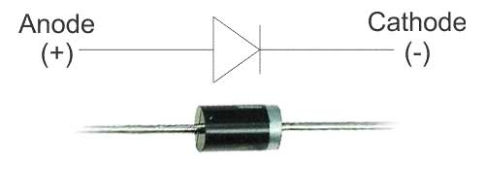
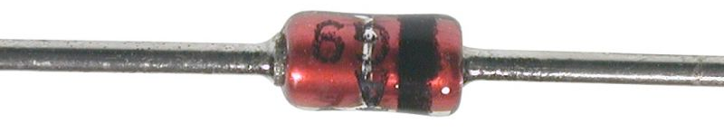
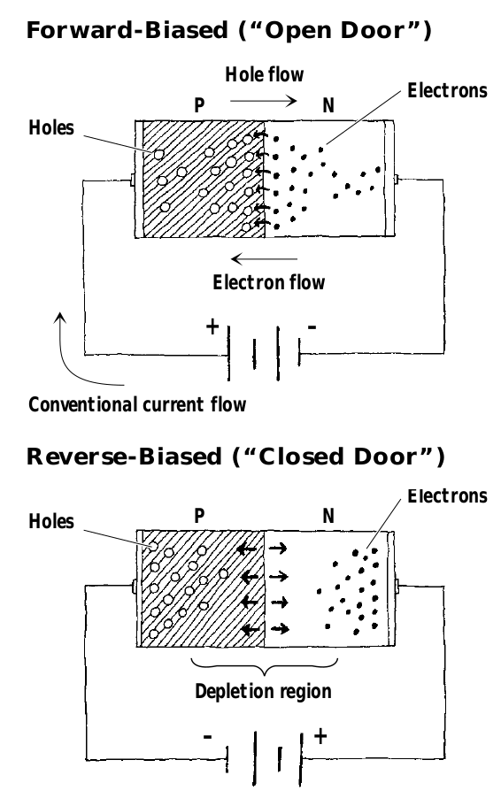
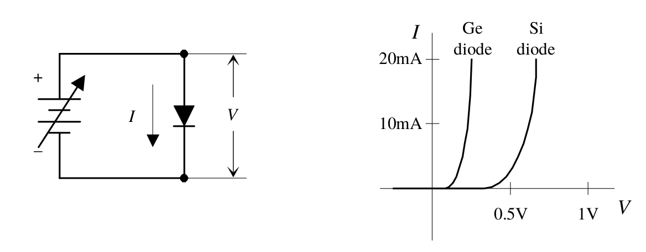
Diodes
Memo
Symbol: D
Threshold voltage
0.7V: most common
0.2V: Schottky
Usages
Rectifier (AC - DC)
Inverted current protection
AM demodulation
Behavior
Similar to a hydraulic valve

Slide 10
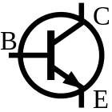
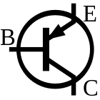
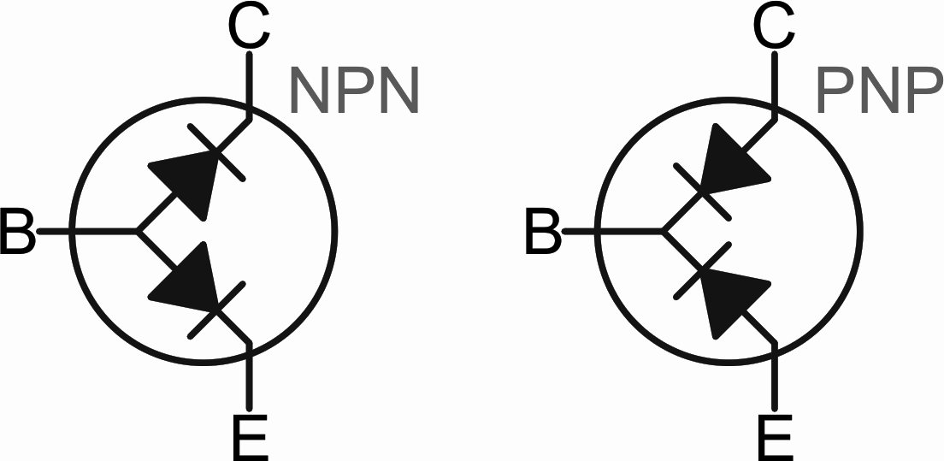
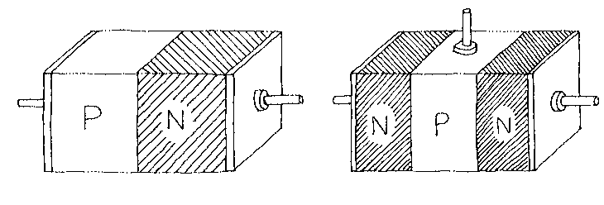
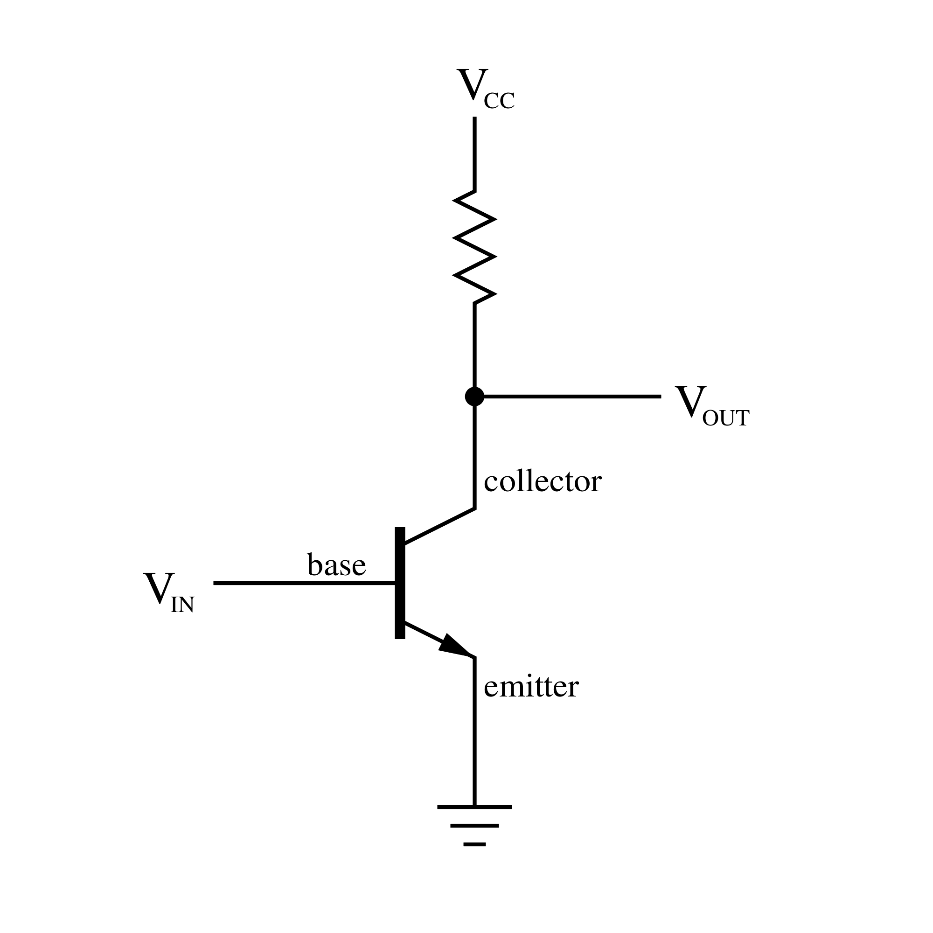
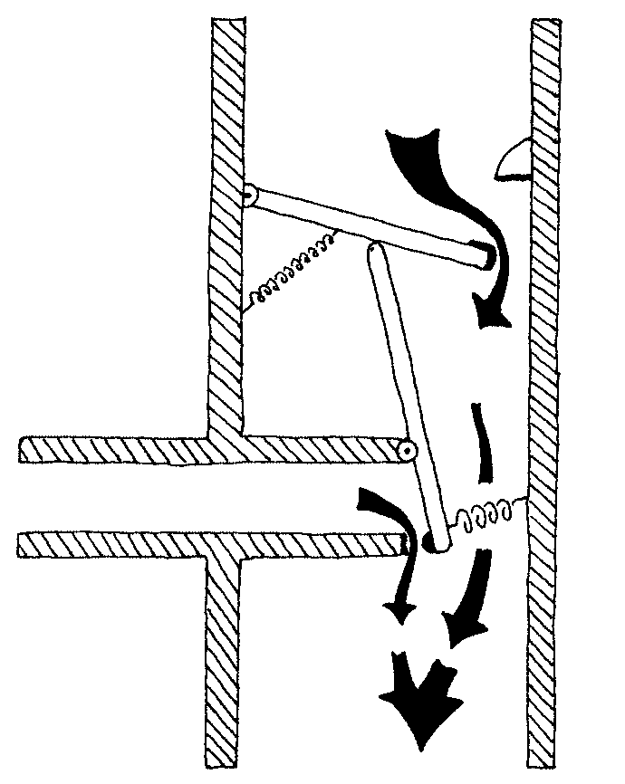
Bipolar transistor
Memo
Current control
Formula: Ic = β Ib
Alias: BJT (Bipolar Junction Trans.)
Usages
Simple amplification
FM demodulation
...
Behavior
Electronically controlled faucet

Slide 11
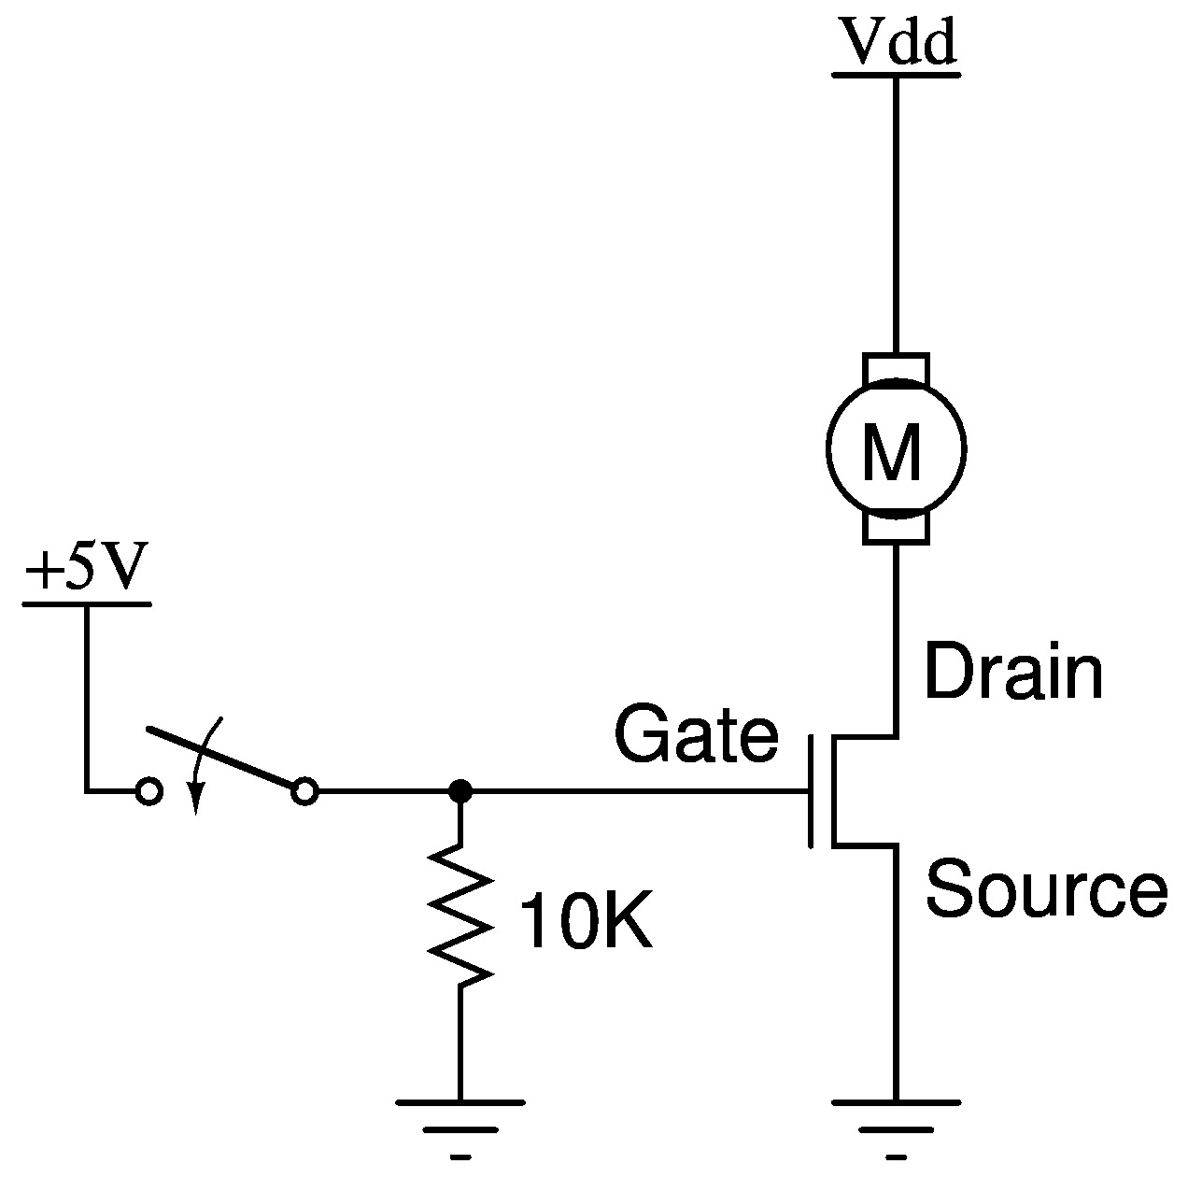
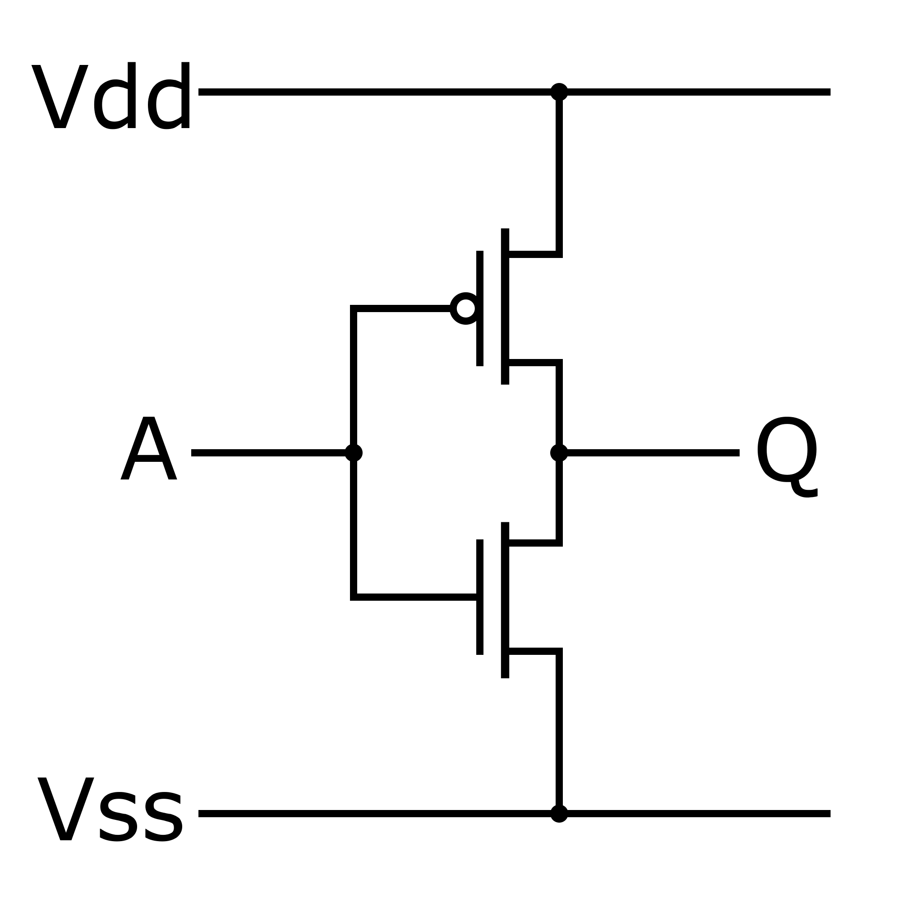
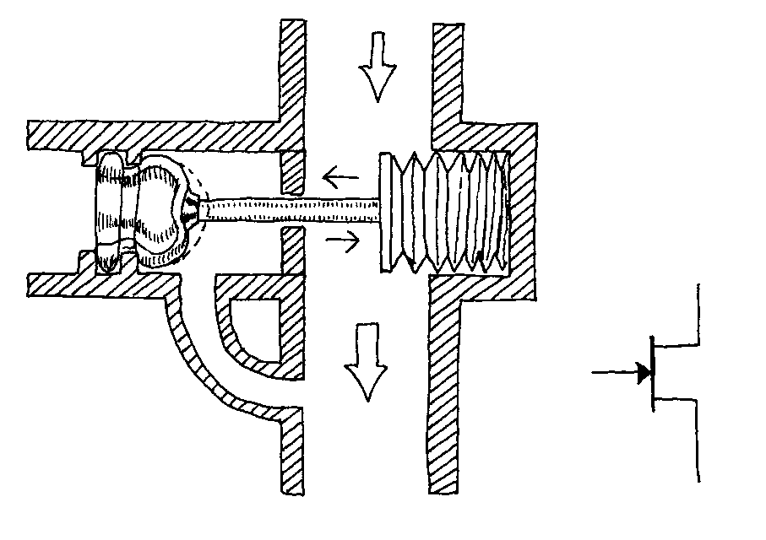

MOS transistor
Memo
Voltage controlled
Common ones: CMOS, MOSFET
Usages
Light control, motors, etc.
Digital electronics (processors, logic gates, etc.)
Behavior
Electronically controlled valve

Slide 12
Optional...

Slide 13
1.c. Logic components
Inverter
AND / OR / XOR gates
D flip flops
PRACTICAL ELECTRONICS FOR INVENTORS
Paul Scherz
(source)

Slide 14
2.a. Fundamental Circuits
Voltage divider
Low Pass Filter (LPF)
High Pass Filter (HPF)
Integrated Circuits (IC)
PRACTICAL ELECTRONICS FOR INVENTORS
Paul Scherz
(source)

Slide 15
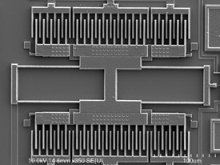
2.b. Sensors
Microphones
Variable resistors (potentiometers / Force Sensitive Resistors / piezoresistors, photoresistors)
Accelerometers...
PRACTICAL ELECTRONICS FOR INVENTORS
Paul Scherz
(source)

Slide 16
2.c. Actuators
Speakers
LEDs (simple, strip..)
Motors (servo, stepper…)
PRACTICAL ELECTRONICS FOR INVENTORS
Paul Scherz
(source)

Slide 17
3. Processors
Microcontrollers
DSP
FPGA (& FPAA)
GPU
PRACTICAL ELECTRONICS FOR INVENTORS
Paul Scherz
(source)

Slide 18
Questions ?
http://is.gd/elec_intro
Notes:
BONUS: MULTIMETER

Slide 19
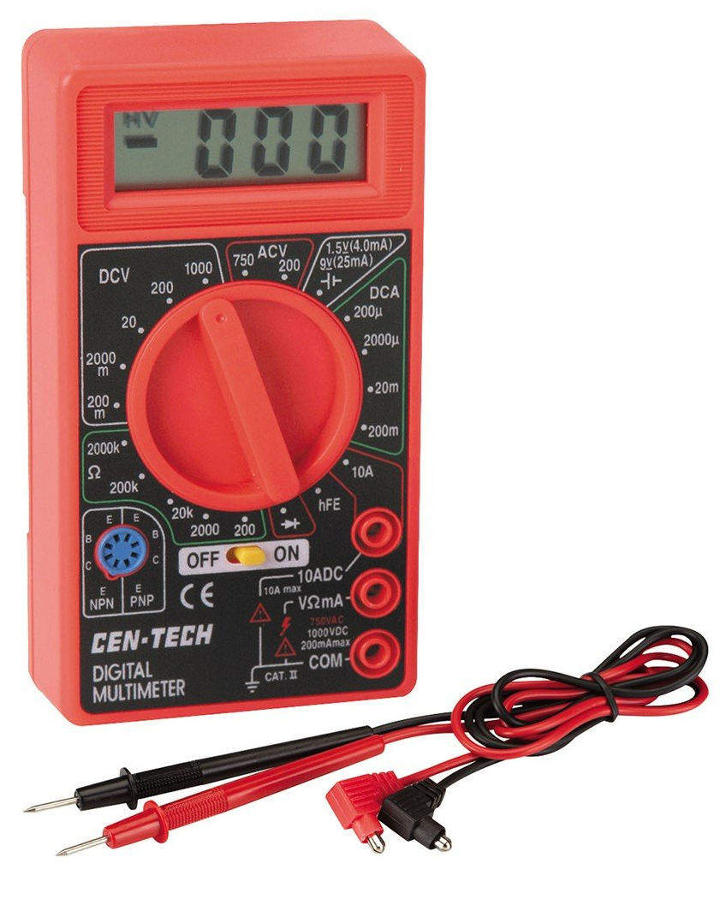
Bonus
Multimeters!?
Notes:
BONUS: MULTIMETER

